Slide 1

Requirements
Abram Hindle Henry Tang
hindle1@ualberta.ca hktang@ualberta.ca
Department of Computing Science
University of Alberta
CMPUT 301 – Introduction to Software Engineering
Slides adapted from Dr. Hazel Campbell, Dr. Ken Wong
Images reproduced in these slides have been included under section 29 of the Copyright Act, as fair dealing for research, private study, criticism, or review. Further distribution or uses may infringe copyright.

Slide 2
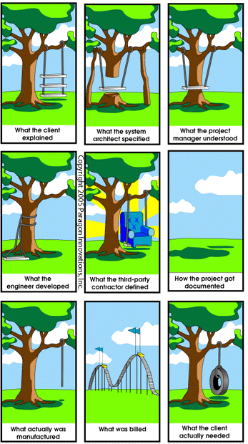
“Requirements”
© 2005 Paragon Innovations Inc.

Slide 3
Importance of Requirements
https://www.projectsmart.co.uk/it-project-management/the-curious-case-of-the-chaos-report-2009.php
Reason for Project Failure | % of Responses
Incomplete requirements | 13.1
Lack of user involvement | 12.4
Lack of resources | 10.6
Unrealistic expectations | 9.9
Lack of management support | 9.3
Changing requirements | 8.7
Lack of planning | 8.1
System no longer needed | 7.5
Notes:
when a bridge fails or a plane crashes, there’s an investigation, with findings made public
when software fails?
Standish 1995 survey of 350 companies and 8000 projects
developers not talking enough with users
- end up having developers developing what they want, not what users want

Slide 4
Requirements
Types:
User requirements
What tasks the user can do with the system
Functional requirements (features)
What behaviors the system does or supports
Non-functional requirements (qualities)
How well the system should do what it does
E.g., response time, resource usage, availability
Notes:
written in natural English, but structured
focus on these three
user requirement
use cases for step by step tasks
user stories sometimes
functional requirements
user stories for features
model behavior using state machines
security

Slide 5
Requirements
Types:
External interfaces
E.g., interfaces to other hardware and software, data sources and sinks, formats, protocols
Physical setting
E.g., location, workspace, lighting, noise, temperature
Developer constraint
E.g., implementation technology, documentation

Slide 6
Requirements
Types:
Business requirements
Why the system is needed
Business constraint
What the system or process must comply with
E.g., corporate policy, industry standard, government regulation

Slide 7
Requirements
Requirements should be:
Correct
Requirements properly represent user needs
Complete
All possible scenarios are described
Consistent
Requirements do not contradict each other
Clear
No ambiguities
Realistic
Can be achieved by “mere mortals”
Notes:
easier said than done
better to be specific
if too vague, it leaves decisions up to the developers, allowing them to build whatever they want to build (which may not satisfy the users)
SMART
specific
measurable
achievable
realistic/relevant
timely/time-bound

Slide 8
Requirements
Also desired:
Traceable
Can trace functionality and tests to the requirement being satisfied
Verifiable
Repeatable test(s) can be designed to show that the system fulfills the requirement
Notes:
number the requirements for easier cross referencing in tasks, change logs, system documentation

Slide 9
Verifiable Requirements
Verifiable?
“The system shall have a good user interface.”
Notes:
can we state it better?
usability (learnable, consistent, etc.) is not a quality you can easily verify with a test
not verifiable, need to validate by involving the user to gain feedback, and possibly through user experiments
Google story

Slide 10
Verifiable Requirements
Verifiable?
“The system shall respond to the user in under one second for most tasks.”
Notes:
which tasks?

Slide 11
Verifiable Requirements
Verifiable?
“When the output state changes, it is logged in the event log.”
Notes:
what is logged? new state and time of state change

Slide 12
Verifiable Requirements
Verifiable?
“The system shall be free of defects.”
Notes:
policy of post-release defects
end user license agreements
disclaimer of warranty
the software is licensed “as-is”
the vendor gives no express warranties, guarantees, or conditions
the vendor excludes implied warranties of merchantability, fitness for a particular purpose,
(to the extent permitted under local laws)

Slide 13
Requirements Activities
Done iteratively:
Requirements elicitation
Discover user needs
Requirements analysis
Decide scope and priorities
Study feasibility
Requirements specification
Document requirements in terms the users can understand
Requirements validation
Check requirements match user needs
Notes:
might start from a problem description
formulating the requirements is a shared exercise
not only the user to specify it
not only the developer to specify it
users and understanding

Slide 14
Users
Who is the “user”?
Primary
End user
With frequent hands-on use
Secondary
Manager of end users
With occasional use, or via an assistant
Tertiary
Owner of the system
Uses output, influences or makes funding decisions
Notes:
stakeholder
have some stake in the use of the system
the “user” you talk to may just be a manager or owner, not the real user
focus on real, representative users

Slide 15
Users
Some characteristics to consider:
Background
Literacy and language
Motivation to learn
Domain knowledge
Task familiarity
Computer skills
Attitude towards computers and technology
Notes:
may be knowledgeable about the domain, but not computers
may be knowledgeable about computers, but not the domain
when you handle the extremes of users, you cover the average user
don’t only focus on the “average user” (your perceptions may be skewed)

Slide 16
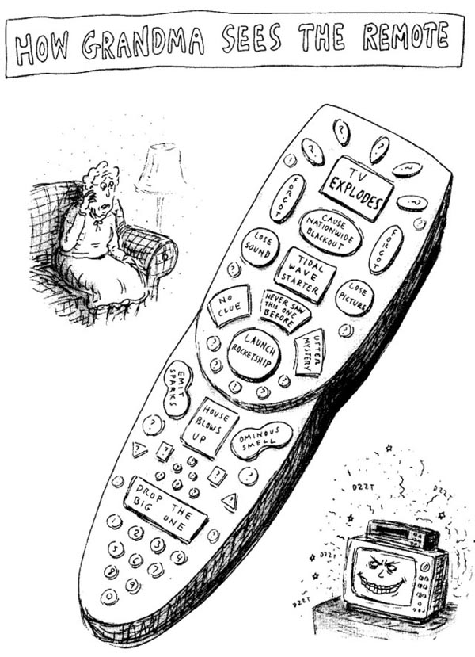
© Roz Chast
Notes:
cartoonist for the New Yorker

Slide 17
Users
User characteristics to consider:
Accessibility needs
Seeing and hearing difficulties
Temporary, permanent, or situational limitations
Perceptual and motor abilities
Fine motor skills with input devices
Touch, pointer, keyboard, or voice input needs
Physical
Height and reach (for kiosk design)
Hand, finger size, and strength (for mobile device design)
Health, age, and gender
Social
Relationships with peers
Culture
Notes:
also finger strength
social characteristics
-

Slide 18
Users
Kinds of use:
Infrequent use/novice user
Need wizards
Need clear prompts, error handling
Frequent use/expert user
Need keyboard shortcuts
Need customization, programmability

Slide 19
Users
Some issues to consider:
Users cannot always express what they want
But they often know what they do not like
Users may not know what is possible
What is technically and economically feasible?
Users stick to what they know already works, or have always done
Users may fear job losses
Leads to non-constructive participation
Notes:
users may want late changes
not always sympathetic to software engineering issues

Slide 20
Users
“Innovator’s dilemma”:
Attributed by Clayton Christensen
As the user base for an application grows, there is a tendency for developers to focus on this increasingly expert (and vocal) group of users
The system becomes more sophisticated
Development becomes “optimized” for them
Notes:
Innovator’s Dilemma
- 1997 book by Clayton Christensen, Harvard Business School
sophisticated and complex

Slide 21
Users
“Innovator’s dilemma”:
Potential new users need “less”
Experts don’t want their app “dumbed down”
Competitor attracts the new users with a simpler “good enough” app
Original app loses market share due to disruption from the low end
Notes:
sustaining
companies geared toward incremental improvements
less or something cheaper
disruptive change
mobile devices
Example: Language learning programs (Rosetta Stone, Pimsleur, etc.) vs. Duolingo, which disrupted the market because it was more accessible (free), addictive, and scalable (even if it is awful for learning languages)

Slide 22
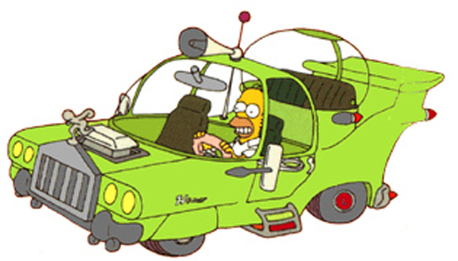
“Listening to Users”
© Fox
Notes:
Simpson’s second season episode
Herb, Homer’s rich (at the time) half brother wants to design a car for the average American
Homer would be perfect representative, and given free rein to give requirements
big motor
huge fins and front grill
sound proof bubble for the kids
problem was, he was the only user consulted
listening to users
need to be respectful, but careful
not always yes

Slide 23
Understanding
Tips:
Manage expectations
Be clear and honest about claims
Avoid surprises, disappointments, hype
Involve the user
Build tangible prototypes to gain feedback
More likely to forgive problems if they are involved
Establish a glossary
Terminology used in the application domain (not programming domain)
Notes:
involve the user
big factor for success, buy-in
in HCI, called participatory design or user-centered design
show something, give alternatives to let the user choose
maybe developers don’t want feedback, because it might force them to make changes
- just like developers don’t like plans, because it shows how behind they are

Slide 24
User Stories
Notes:
a way to specify needs

Slide 25
Specifying Needs
Old (waterfall) method:
Agile method: less writing, more talking
Write down all the requirements
Users get what they want.
Users only get what was written
Notes:
from agile development, where they found use cases were too documentation heavy
shift focus from writing to talking
get validation by involving the user
less structured than use cases
but not much detail on user tasks
can be augmented by use cases
for 301, given user stories (needs), you write fully dressed use cases
- user tasks important when designing interactive, conversational applications
users also have to learn to talk to developers

Slide 26
Specifying Needs
User story:
Written description of what a user wants to achieve with the system
As a guest, I want to reserve a hotel room.
Organized on index cards
As a guest, I want to see a list of room amenities.
Typical forms:
As a «user role», I want «goal».
As a «user role», I want «goal», so that «reason».
As a conference planner, I want to see meeting room capacities.
Notes:
describes some functionality that will be valuable to the user
understandable to the user
simple enough to have been written by the user
involves the user
see list of room amenities, so that
- I can check it has internet, preferably free
focus on user goals

Slide 27
Defining User Stories
Tips:
Describe what not how
Avoid technical details or choices of technologies, unless it is a development constraint
Avoid epics for near-term needs
Better to split up huge stories into more, smaller stories (but not too small)
Notes:
epics
hard to estimate for
hard to plan

Slide 28
Defining User Stories
Tips:
Prioritize user stories
Discuss with the user what they find of most value and stage development on that first
Can attach an effort estimate to complete
Normally sized to take days, not many weeks
Use stories to plan development tasks
Create work items in the iteration plan
Notes:
estimation difficulties
story is too big
developers lacking application domain or technical knowledge (do a feasibility study, throwaway prototype, spike)
for 301, user stories and use cases for certain tasks

Slide 29
“SMART Work Items”
https://xp123.com/invest-in-good-stories-and-smart-tasks/
S | Specific
M | Measurable
A | Achievable
R | Relevant
T | Time Boxed
Notes:
specific
everyone understands what’s involved
measurable
we know what it means to be done with it (coded, tested, documented)
achievable
relevant
contributing to a valued story
time boxed
assigned to specific iteration

Slide 30
“INVEST in Good Stories”
https://xp123.com/invest-in-good-stories-and-smart-tasks/
I | Independent
N | Negotiable
V | Valuable
E | Estimable
S | Small
T | Testable
Notes:
independent
doable in any order (not always possible)
combine stories to avoid dependencies, but that makes epics
negotiable
not a contract, not all details
details give false impression of completeness
valuable
depends on user (end user or owner)
owner might want the project to pass an ISO 9001 audit or be managed in compliance with CMMI level 3, or a specific market share
estimable
small (sized appropriately)
small for near term
epics fine for further out
testable

Slide 31
Testable User Stories
Front of the card:
As a meal planner, I want to see nutrition information for a given amount of a given food.

Slide 32
Testable User Stories
Back of the card:
Link:
https://ronjeffries.com/xprog/articles/expcardconversationconfirmation/
Try it for 250 g of baked Pacific salmon.
Try it with a missing food name.
Try it with a non-numeric amount.
Acceptance tests
Notes:
3 C of user stories by Ron Jeffries
card
conversation with user
confirmation with tests
acceptance tests
done by user when taking acceptance of the system
or enabled by developer, possibly with automated test scripts
non necessarily stress testing

Slide 33
“User Story”
http://www.dilbert.com/strips/comic/2003-01-10/

Slide 34
Use Cases
Notes:
the kinds of development jobs where you are given a finished set of requirements
tend to be the kinds of jobs that are easily outsourced or offshored
not bad if it’s a programming task outsourced to Canada from the US
you may not be able to compete against a team from Romania, India, or China who could do it cheaper
use your communication skills and maybe local knowledge to advantage
big demand for business analysts
work with clients to figure out their needs
liaison to developers
rather than doing grunt work making web pages
figuring out and specifying what tasks the user should be able to do
also functional requirements (features that support those tasks)

Slide 35
Identifying Tasks
Study what tasks users do:
What is the goal and context?
What information is needed?
What are the steps?
Who does the user work with?
Why is it done this way?
Notes:
might be without automation, and you are designing a computer system
might be with automation, and that needs improvement
how to do this?
ask or talk to them
watch them
issue a questionnaire
read existing documentation
think about future scenarios rooted in existing tasks
think about improving efficiencies

Slide 36
Identifying Tasks
Scenario:
An informal narrative
Personal and concrete, but not particularly general
Use the scenario to understand existing goals, task flow, and possible irritants

Slide 37
Scenario
Example:
“I want to track the calories for a meal, so I consult the USDA Nutrient database. I want to look up ‘Pacific salmon’ so I enter that as the keywords. Item not found! So, I enter ‘salmon’ and try again. That works, but I get 46 items, including salmonberries and even cloudberries. Why? I choose ‘fish, salmon, sockeye, cooked, dry heat’, then figure 2.5 x 100 g units for my item and scan the table to see 422 kcal in the energy row.”
Notes:
http://www.nal.usda.gov/fnic/foodcomp/search/
irritants
getting the item right
too many choices, even irrelevant ones
multiple of 100 g
scanning table

Slide 38
Specifying Tasks
Use Cases:
Capture the goal, conditions, and steps of a coherent interaction between the actor(s) and the software system
More general than a specific scenario
Written from a “user” point-of-view
Notes:
idea initially formulated by Ivar Jacobson (from Ericsson) in 1986
actor is a user role (like end user, manager, administrator)
take the scenarios or results of watching users, and define use cases

Slide 39
Defining Use Cases
Stages:
Identify the actors
Consider different user roles and external systems
Define use cases
Include all cases of use
Refine use cases
Consider exceptional conditions and qualities
Relate use cases
Consider inclusion and extension dependencies
Notes:
use cases have a diagrammatic part and a textual part
then it’s OO analysis (identify objects) after this

Slide 40
Identify the Actors
Use case diagram
Search for Nutrition Info
Use cases,
not components
Meal Planner
Browse Nutrition Info
Actor
Update Nutrition Info
Administrator
Boundary of the system
Notes:
similar to context diagram
also relate actors to use cases with association, and what use cases (tasks) are supported by the system
- not features of the system (like search and browse components)
not always one user and the system, could have one user communicate with a second user through the system
actor could be an external system
- e.g., other database system that the search talks to

Slide 41
Identify the Actors
Actor generalization:
User
Meal Planner
Administrator

Slide 42
Define/Refine Use Cases
Example:
Use Case Name
Participating Actors
Goal
Trigger
Precondition
Post-condition
SearchForNutritionInfo
Meal Planner (primary)
Meal Planner finds nutrition information
Meal Planner chooses the Search option
Meal Planner knows food name and amount.
On success, nutrition information displayed.
…
Notes:
fully dressed example versus simplified
- use this as a basis of a template for project use cases
unique name, or use an ID
primary actor here is a Meal Planner
use case describes this actor trying to achieve a goal
point of view is the user

Slide 43
Define/Refine Use Cases
User point of view
Example:
Basic Flow 1
2
3
4
5
6
7
System prompts Meal Planner to enter keywords
Meal Planner submits keywords.
System lists matching foods, prompting for a selection.
Meal Planner browses and selects a food.
System prompts for food weight in units of 100 g.
Meal Planner enters food units.
System presents nutrition data for the amount of food.
…
Avoid implementation specifics
Notes:
shows the interaction (back and forth exchange)
- use cases are suited for capturing non-interactive requirements (e.g., algorithmic requirement)
system is considered a black box (no detail on how it internally works)
focus on what the system does, not how (e.g., queries database)
generally try to avoid implementation specific language
like user interface specifics, clicking OK button
passwords are just one choice of authentication technology
can be awkward to abstract out the user interface

Slide 44
Define/Refine Use Cases
Example:
Exceptions 3
3.1
3.2
7
If there are no matching foods
System displays an error
System returns to step 1
If given food units is non-numeric, use 0 and proceed
Notes:
could add enough detail to help develop test cases
- in a more critical application, could specify field length, ranges, default values, whether a field is mandatory or optional
more detail when
- team members cannot meet easily
- comprehensive testing needed
good detail, but some resistance at the level of formality
if flow gets very complex, might be better to use a UML activity diagram (flow chart)

Slide 45
Define/Refine Use Cases
Example:
Qualities
Constraints
Includes
Extends
Related Artifacts
Notes
Open Issues
System responds in under 2 s for list of matching foods and for nutrition data on a specific food.
Use USDA nutrition data.
Notes:
related artifacts (optional)
forward traceability to a design artifact (UML class diagram with relevant classes)
link to user interface mockup or storyboard

Slide 46
Essential Use Case
SearchForNutritionInfo
User Intention (Meal Planner) | System Responsibility
Initiate search.
 | Request keywords.
Submit keywords.
 | List matching foods to select.
Select a food.
 | Request food units.
Enter food units.
 | Present nutrition data.
Notes:
also called business use case

Slide 47
Exercise
Question:
What is a basic flow for the task of withdrawing cash from a bank machine?
Notes:
HCI
task analysis
cognitive walkthrough
would the user know what to do next?
you’ll know it when it wasn’t thought through (no flow)
eyes jumping around the dialog
hands moving a lot between keyboard and mouse
more mistakes
(system prompts)
user inserts card
(system prompts for language
user chooses language)
system prompts for PIN
user enters PIN
system shows choices
user chooses withdraw cash
system prompts for amount
user enters amount
system ejects card (card before cash), highlighting slot
user takes card
system prints receipt
system dispenses cash
common mistake at chip terminals is forgetting to take back the card
consider chip card transaction, and forgetting card

Slide 48
Relate Use Cases
Inclusion:
A use case may include another use case (for necessary, shared behavior)
Pay Bill Online
«include»
Login
«include»
Get Balance Online
Notes:
administrative tasks
consolidate and eliminate redundancies among use cases
included use case is required

Slide 49
Relate Use Cases
Extension:
A use case may be extended by another use case (for optional or exceptional behavior)
Reset Password
«extend»
Login
Notes:
log error if debugging enabled
some ambiguity here

Slide 50
Relate Use Cases
Use case generalization:
A use case may be a specialization of a more general use case
Do ATM Transaction
Make Deposit
Make Withdrawal

Slide 51
Augmenting Requirements

Slide 52
Augmenting Requirements
Can add other descriptions, for example:
Use cases to user stories
Data schemas
Sample input and output
User interface mockups and storyboards
Grammars (language syntactic/lexical structure)
identifier
letter
<identifier> ::= <letter> { <letter> | <digit> }
letter
digit
Notes:
storyboard is a state model
state models
blurred line between requirements and design

Slide 53
State Models
Modeling behavior:
Used in formally modeling the behavior of a specific object in response to external events
Describe how an object changes over time
Show how behavior depends on the object’s current state
Common use:
User interface modes
Workflows
Objects with lifecycles

Slide 54
UML State Diagram
Modeling behavior:
States in which something can be in
A situation represented by attribute values
Directed transitions between states
Triggered by events, input, time, messages, etc.
Start / toggle := true
start
Transition
Off
On
Initial state
State
Stop / toggle := false
stop
Notes:
state of something
- if that something is you
- you might be in a happy state or sad state
something can be the system, a state representing a snapshot of its memory
often too big, 2 boolean variables, need four states
something more specific, maybe a specific object
if the thing is in a certain state, and a matching event occurs, take the corresponding transition, doing the action, to the next state
also finite state machine, state transition network, state chart
- not a flow chart (transition takes place when matching event happens)
later, how to implement a design for this

Slide 55
UML State Diagram
Room unavailable / put on waiting list
Room available / decrement room count
Requested
Room available / decrement room count
Reserved
Waiting
Client checks in /
Client gives up / remove from list
Client cancels / increment room count
Checked In
Canceled
A final state
Client checks out / increment room count
Trigger / effect
Archived
Notes:
behavior of a hotel reservation system for a client user
states of a client user record object
trigger / effect
choice (branching) at Reserved
used for complex behaviors
communication protocols (network connection object in a connected state, sending state, waiting for acknowledgement state, disconnected state)
user interfaces (clipboard)

Slide 56
UML State Diagram
States:
State name
State name
State name
Activities
Variables
Activities
Notes:
something is in a certain state at some point in time
atomic actions
can add processing to states
- confounds the notion that state diagrams and flow charts are different things
state of being happy, of smiling, of having candy

Slide 57
UML State Diagram
Transitions:
If in the current state, and the trigger occurs, and the guard constraint (if any) is true …
Then, the object:
Performs state exit actions (if any)
Performs the transition effect (if any)
Performs new state entry actions (if any)
Otherwise, stay at current state.
trigger [ guard ] / effect
General form of transition label
Notes:
optional parts
no guard
no transition effect
transitions are essentially instant

Slide 58
UML State Diagram
Transitions:
If in a current state, and trigger occurs, and guard constraint (if any) is true …
Then perform state exit actions (if any), perform corresponding transition effect (if any), perform new state entry actions (if any);
Otherwise, stay at current state.
trigger [ guard ] / effect
General form of transition label
Notes:
optional parts
no guard
no transition effect
transitions are essentially instant

Slide 59
UML State Diagram
Activities in states:
entry / action | perform action when entering state
do / action | perform action while in state
exit / action | perform action when exiting state
Timing
Timeout
Ready
do / countdown
entry / beep

Slide 60
UML State Diagram
Also called an internal transition
Activities in states:
trigger / action | when trigger occurs, perform action
SettingDay
SettingMonth
entry / start day blink
button1 / increment day exit / stop day blink
button2
entry / start month blink
button1 / increment month
exit /
stop month blink
button3
Notes:
example for setting the day and month on a watch
can have composite state including a state diagram inside it

Slide 61
Room Planner
Canvas:
Place and move items
Mouse events:
Click
Press / drag / release
Item type menu:
Choices of fixtures and furniture

Slide 62
Room Planner
Placing an item:
User clicks on empty space on the canvas
System shows the item type menu
User chooses an item type from the menu
System hides the item type menu
User clicks on the canvas
System draws item of the chosen type at the mouse location
Notes:
What state?
Choose an item type from the menu -> system enters placing mode
Click on the canvas after selecting an item type -> system returns to waiting mode

Slide 63
Room Planner
Moving an item:
User presses inside an item
System highlights item
User drags item
System shows moving item
User releases mouse
System places item at new location
System removes item highlighting
Notes:
what states?
Pressing an item -> moving mode
Release the mouse -> return to waiting mode

Slide 64
Room Planner
States:
Waiting
Nothing happening
Choosing
Choosing item type from menu
Placing
Waiting for user to click a location
Moving
Moving an item to a new position

Slide 65
click [outside any item] /
show menu
Choosing
press [inside item F] / current := F; highlight current
Moving
current (x, y)
choose item type /
hide menu
Waiting
erase current; update current.x; update current.y; draw current
release / unhighlight current
Placing
click /
draw item at mouse location
drag (x, y)
Notes:
drag is example of iteration
(x, y) is location of mouse
easier to check for incompleteness in diagram than in textual description
what if user places on top of another item?
states reachable?
missing transitions?
missing events to consider?
getting stuck in a state

Slide 66
UML State Diagram
Tips:
Check for completeness
States reachable?
Missing transitions?
Events not considered?
Unforeseen situations?
Check for dangerous situations
E.g., exiting without having saved edits
Notes:
better to find out problems early, than later in testing
use model checkers

Slide 67
UML State Diagram
Tips:
Check for consistency
Similar interactions have similar effects?
Effects are visible and give good feedback?
Aid the user
Is undo appropriate in each state?
Is cancel or escape appropriate?
Is invoking help appropriate?
Notes:
reversibility
does it make sense to go back to previous states (undo)
is help relevant in a state?

Slide 68
More Information
Books:
The Essence of Object-Oriented Programming with Java and UML
B. Wampler
Addison-Wesley, 2002
UML Distilled
M. Fowler
Addison-Wesley, 2003
User Stories Applied
M. Cohn
Addison-Wesley, 2004

Slide 69
More Information
Books:
More About Software Requirements
K. Wiegers
Microsoft, 2006
Software Engineering: Theory and Practice
S.L. Pfleeger
Prentice-Hall, 2009

Slide 70
More Information
Links:
Effective User Stories for Agile Requirements
https://www.mountaingoatsoftware.com/presentations/introduction-to-user-stories

